Slide 1
TITLE:MIS for Online Examination and Result Processing
Presented by,
Snegha C-192110562
Sathyapriya S-192110246

Slide 2

MIS for Online Examination and Result Processing
This presentation outlines a Management Information System (MIS) for online examinations. The system automates exam delivery, answer evaluation, and report generation. It offers role-based access, ensuring security and efficiency for both students and faculty. The system is designed to handle more than 1,000 students with real-time result processing.

Slide 3

Importance of Online Examination in Education
Accessibility
Efficiency
Cost Savings
Online exams expand educational reach. They accommodate students from diverse locations.
Automated grading and reporting save time. They reduce administrative burdens.
Reduced paper use and logistical costs. This makes education more affordable.
Real-Time Feedback
Students get faster performance insights. This supports continuous improvement.

Slide 4

Key features of online Examination
1
Automated Grading
Instant evaluation of objective questions, reducing manual effort and time.
2
Secure Access
Role-based access control ensures data privacy and prevents unauthorized access.
3
Real-Time Reporting
Immediate performance feedback and comprehensive analytics for students and faculty.
4
Scalability
Designed to handle 1,000+ students concurrently, ensuring seamless performance.

Slide 5

Role-Based Access Control: Security and User Management
1
Administrator
Full access to system configuration, user management, and report generation. Responsible for maintaining system security and integrity.
2
Faculty
Access to exam creation, grading, and result viewing. Can manage student enrollments and provide feedback on performance.
3
Student
Access to exam taking and result viewing. Limited access to personal data and performance reports. Cannot modify exam content or data.

Slide 6
System Architecture: A Holistic View
Frontend
Backend
Database
User-friendly interface for students and faculty. Features include exam access, submission, and report viewing.
HTML5,CSS3,JAVASCRIPT,REACTJS
Robust server-side logic for exam management, evaluation, and data storage. Designed for high availability and scalability.
Secure storage for exam content, student data, and results. Optimized for efficient data retrieval and real-time processing.
MONGODB5.0,POSTGRESQL

Slide 7
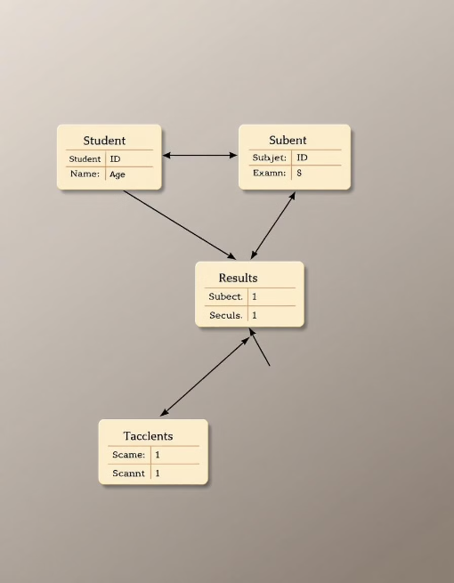
Database Design: Scalability for 1,000 Students
Student Table
Exam Table
Results Table
Stores student IDs, names, and login credentials. Includes fields for enrollment details and course information.
Stores exam IDs, titles, and question sets. Manages exam schedules and access permissions for different user roles.
Stores student answers, scores, and submission timestamps. Enables real-time result calculation and performance tracking.

Slide 8





Input Mechanisms: Exam Interface and Answer Collection
Exam Interface
Answer Collection
Data Validation
Web-based interface for displaying questions and accepting student responses. Supports multiple question types and secure submission.
Automated collection of student answers during the exam. Ensures data integrity and prevents unauthorized access or modification.
Real-time validation of input data to prevent errors and ensure data quality. Includes checks for completeness and format compliance.

Slide 9
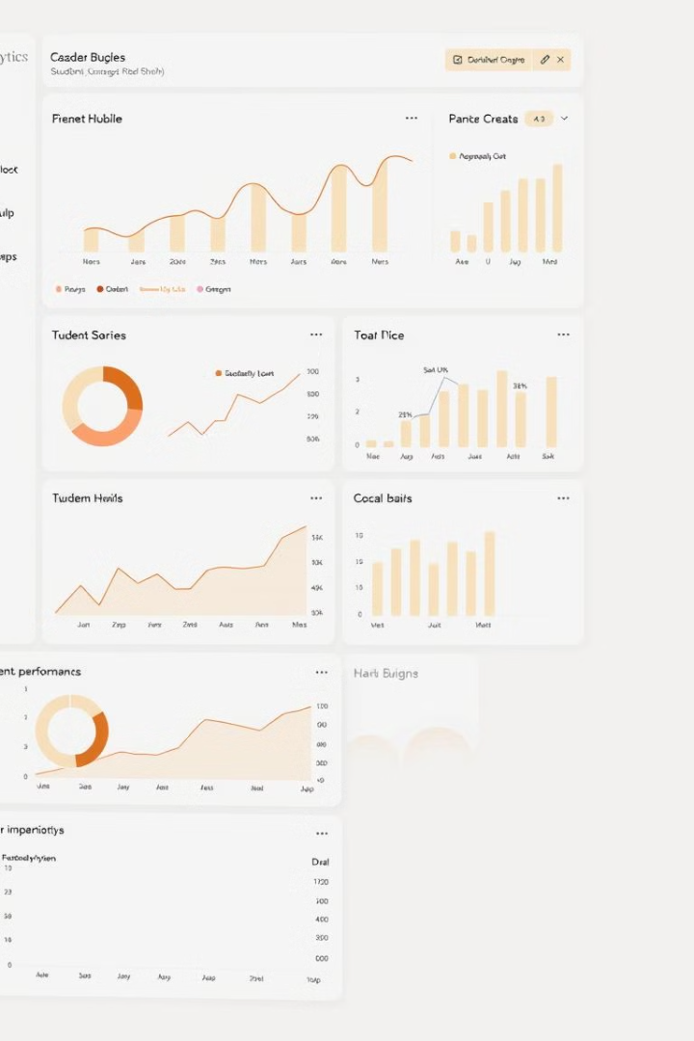



Output Reports: Real-Time Performance Analytics
Score Distribution
Detailed Reports
Performance Trends
Graphical representation of score distribution for each exam. Identifies areas of strength and weakness in student performance.
Comprehensive reports with individual student scores and question-wise analysis. Supports drill-down into specific areas of interest.
Track student performance over time to identify learning patterns and trends. Enables early intervention and personalized support.

Slide 10



Hardware and Software Requirements: Infrastructure Overview
Database
Scalable database system for storing exam content, student data, and results. Optimized for efficient data retrieval and real-time processing.
PostgreSQL ,MangoDB
12 core intel xeon silver
Ram 128 GB.
2
Servers
High-performance servers for backend processing and data storage. Types of severs
Application server Web server Database Server
Intel xeon gold 6248 processor it has capacity of 2TB.
1
Network
High-bandwidth network infrastructure for supporting concurrent user access. Ensures low latency and reliable connectivity during exams.
Cisco catalyst 9300 series it is a router.
3

Slide 11
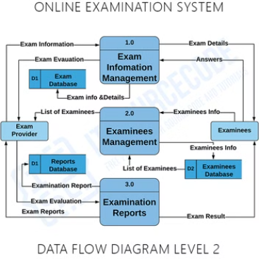
Implementation Flow: From Exam Creation to Result Generation
A typical online examination flowchart would include the following key elements: User Login/Registration, Accessing Exam Details, Viewing Questions, Answering Questions, Submitting Exam, Result Generation, and Admin Panel for managing exams and questions; encompassing steps like student registration, login, selecting an exam, displaying questions, recording answers, time management, submission confirmation, and viewing results, with potential additional features like proctoring, feedback, and question bank management depending on the system complexity.

Slide 12

Real Time Result Generation
1000
Students
System can manage this number of students simultaneously.
10
Seconds
Time needed to generate results in real time.

Slide 13
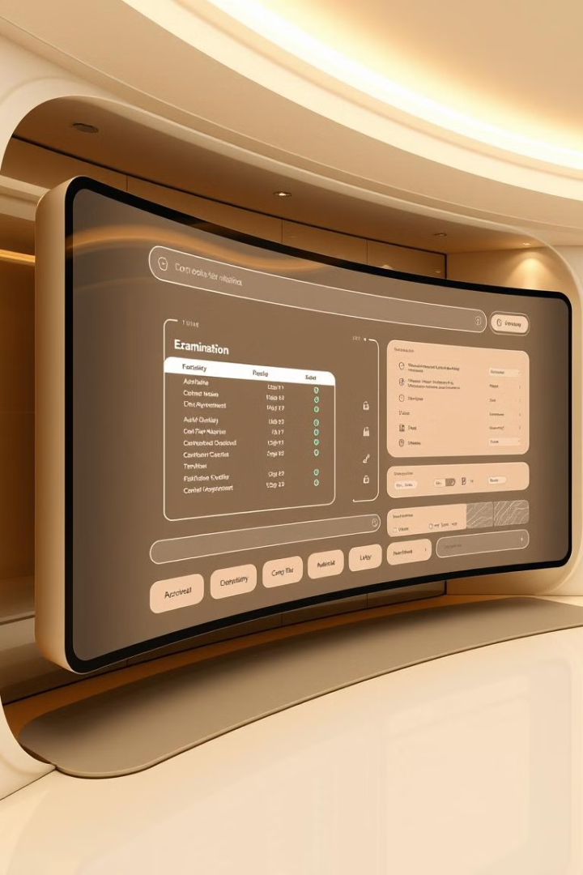



Future Enhancements
The MIS system is built for future growth. It supports integration of new features and technologies.
AI Proctoring
Implement AI for monitoring exams.
Blockchain Integration
Enhance security with blockchain.
Mobile Access
Enable exam access on mobile devices.

Slide 14

Performance Metrics for Evaluation
Analyze system efficiency to identify bottlenecks. Use data-driven insights for continuous improvement.
System Load
Response Time
Measures concurrent users and exam load.
Tracks time to load pages and generate reports.
Error Rate
Monitors exam disruptions or data loss.

Slide 15
Steps in Developing the Online Examination System
Testing
Implementation
Test to make sure all components work correctly.
Design
Code, integrate, and test system modules.
System Analysis
Create database, interface, and security components.
Determine requirements and goals for system design and functionality.

Slide 16
Advantages and Disadvantages of Online Examination
Advantages
Disadvantages
Cost reduction in logistics.
Dependence on reliable internet.
Increased accessibility for remote students.
Potential for cheating.
Instant grading and feedback.
Requires digital literacy.

Slide 17

Conclusion
Our MIS enhances exam efficiency and integrity. It provides real-time analytics for informed decisions.
1
Enhanced Efficiency
2
Data-Driven Insights
Streamlines the exam process from creation to result generation.
Provides real-time analytics to improve teaching and learning.
3
Future-Ready
Built for scalability and integration of new technologies.

